Slide 1
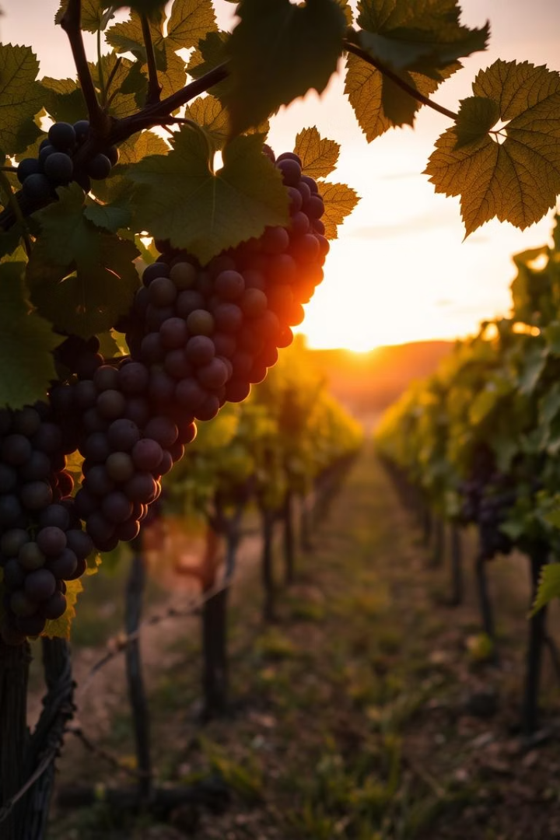

Wine Percentage Prediction
Satyajit Routray 2301030076
Swastick Sourav Singh 2301030057
Shakti Swaroop Priyadarshan 2301030026
Swayamshu Mandal 2301030030

Slide 2
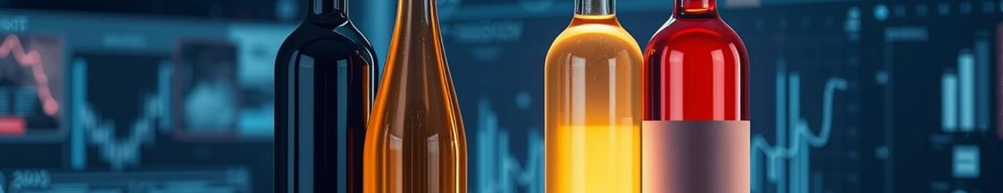
Wine Percentage Prediction: An AI Approach
Machine Learning Techniques
Data & Models
Quality Control
Explore datasets, feature engineering, and model selection.
Improve labeling accuracy and wine quality monitoring.
Predict Alcohol by Volume (ABV) using advanced models.

Slide 3
Understanding Wine Composition and ABV
ABV Importance
Influencing Factors
Measures alcohol content affecting taste and body.
Grape varietal and ripeness
Legally regulated with ±0.5% labeling tolerance.
Fermentation process
Winemaking techniques

Slide 4
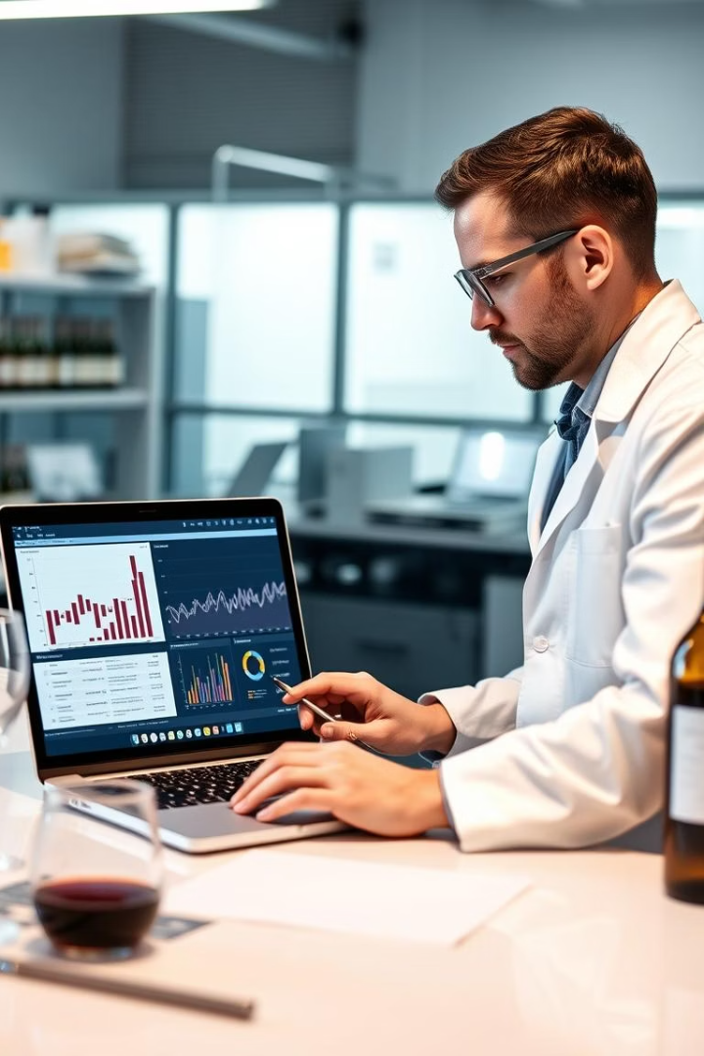
Data Collection and Preparation
Datasets
Features
Using UCI wine quality datasets with rich chemical features.
Includes acidity, sugar, sulfur dioxide, pH, alcohol, and more.
Data Cleaning
Handling missing values, outliers, and engineering ratios.

Slide 5
Machine Learning Models for ABV Prediction
Linear Regression
Random Forest
Support Vector Regression
Baseline model to compare predictive accuracy.
Ensemble technique offering higher precision and robustness.
Effective in handling complex, high-dimensional data.

Slide 6

Model Training and Evaluation
1
Data Splits
2
Hyperparameter Tuning
Training 70%, validation 15%, testing 15%.
Grid search to optimize model performance.
3
Metrics
RMSE, R-Squared, and Mean Absolute Error evaluated.

Slide 7
Results and Findings
Model Performance
Feature Importance
Linear Regression RMSE: 0.8
Key factors: sugar levels, acids, and sulfur compounds.
Random Forest RMSE: 0.4 (best)
Top model accuracy ±0.3% ABV on test data.
SVR RMSE: 0.5

Slide 8





Applications and Benefits
Quality Control
Labeling Accuracy
Winemaking Optimization
Consumer Transparency
Real-time ABV monitoring during fermentation.
Ensures regulatory compliance and consumer trust.
Adjust fermentation for desired ABV levels.
More accurate information on wine labels.

Slide 9
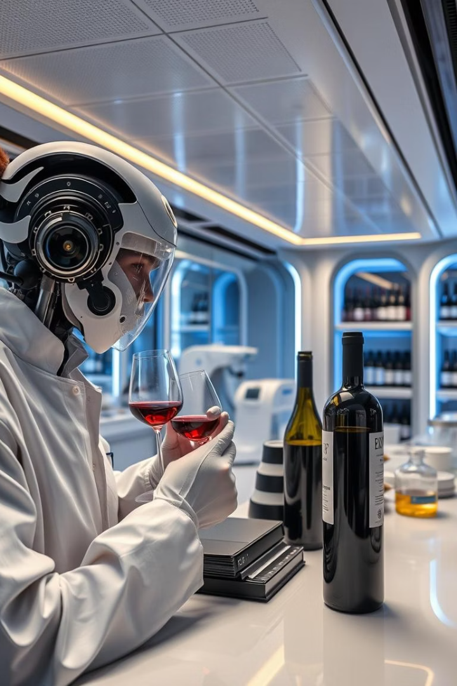




Conclusion and Future Directions
Current Impact
Accurate ABV prediction using machine learning.
Future Work
Expand datasets and integrate sensory and aroma data.
Advanced Models
Explore deep learning for enhanced prediction.
Personalization
Tailored wine recommendations based on ABV preferences.

